Slide 1
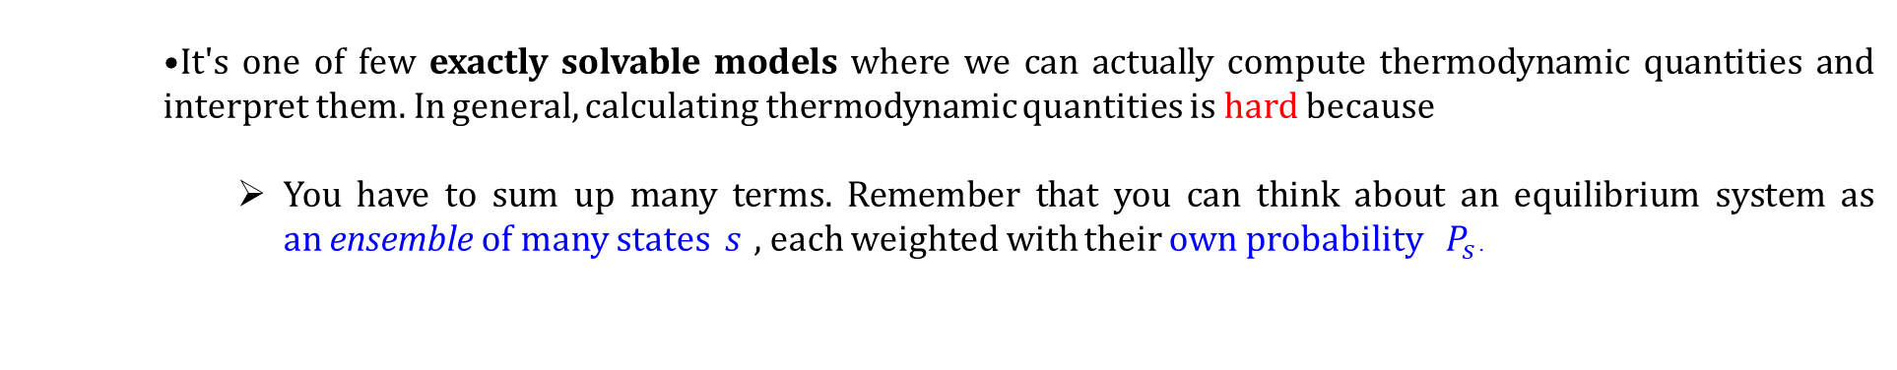
Ising Model: Motivation
Why should we spend so much time talking about the Ising model?
It's surprisingly useful for helping us think about all sorts of behaviors relating to phase transitions. For instance:
It exhibits symmetry breaking in low-temperature phase .
‘Critical point’ at a well-defined temperature
It's one of few exactly solvable models where we can actually compute thermodynamic quantities and interpret them. In general, calculating thermodynamic quantities is hard because
You have to sum up many terms. Remember that you can think about an equilibrium system as an ensemble of many states $s$ , each weighted with their own probability $P_{s}$ .
Statistical Physics Seminar by Prof. Wolschin
Anton Kabelac
https://stanford.edu/~jeffjar/statmech/lec3.html

Slide 2
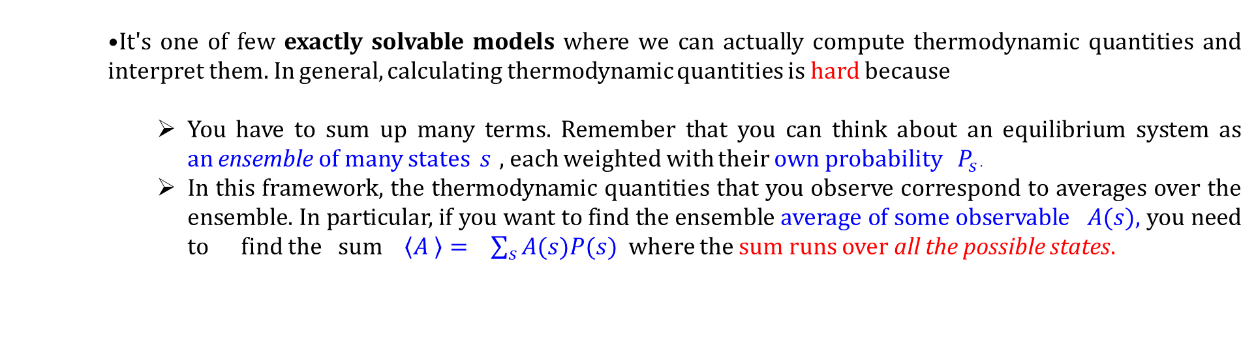
Ising Model: Motivation
Why should we spend so much time talking about the Ising model?
It's surprisingly useful for helping us think about all sorts of behaviors relating to phase transitions. For instance:
It exhibits symmetry breaking in low-temperature phase .
‘Critical point’ at a well-defined temperature
It's one of few exactly solvable models where we can actually compute thermodynamic quantities and interpret them. In general, calculating thermodynamic quantities is hard because
You have to sum up many terms. Remember that you can think about an equilibrium system as an ensemble of many states $s$ , each weighted with their own probability $P_{s}$ .
In this framework, the thermodynamic quantities that you observe correspond to averages over the ensemble. In particular, if you want to find the ensemble average of some observable $A(s)$, you need to find the sum $\left\langle A \right\rangle = \sum_{s}{A(s)P(s)}$ where the sum runs over all the possible states.
Statistical Physics Seminar by Prof. Wolschin
Anton Kabelac
https://stanford.edu/~jeffjar/statmech/lec3.html

Slide 3
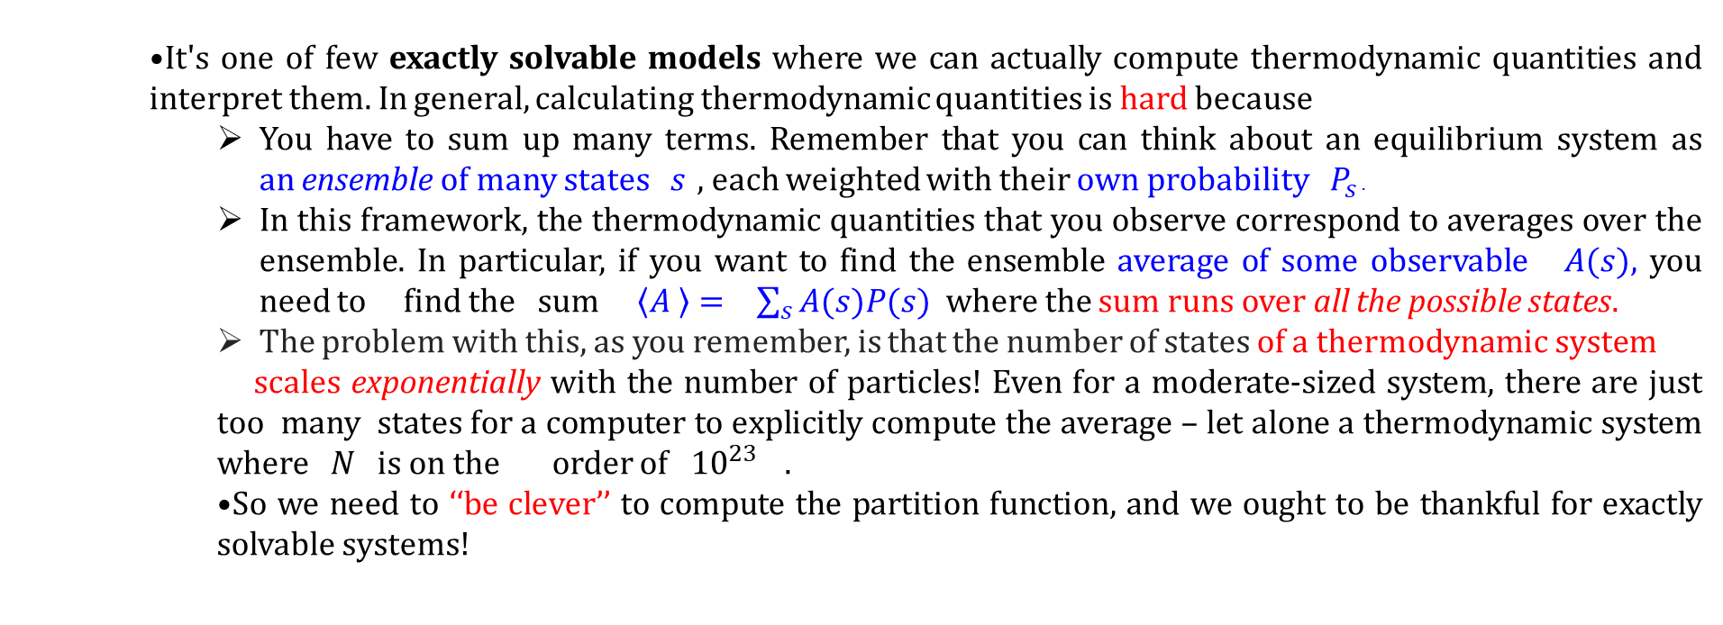
Ising Model: Motivation
Why should we spend so much time talking about the Ising model?
It's surprisingly useful for helping us think about all sorts of behaviors relating to phase transitions. For instance:
It exhibits symmetry breaking in low-temperature phase .
‘Critical point’ at a well-defined temperature
It's one of few exactly solvable models where we can actually compute thermodynamic quantities and interpret them. In general, calculating thermodynamic quantities is hard because
You have to sum up many terms. Remember that you can think about an equilibrium system as an ensemble of many states $s$ , each weighted with their own probability $P_{s}$ .
In this framework, the thermodynamic quantities that you observe correspond to averages over the ensemble. In particular, if you want to find the ensemble average of some observable $A(s)$, you need to find the sum $\left\langle A \right\rangle = \sum_{s}{A(s)P(s)}$ where the sum runs over all the possible states.
The problem with this, as you remember, is that the number of states of a thermodynamic system
scales exponentially with the number of particles! Even for a moderate-sized system, there are just too many states for a computer to explicitly compute the average – let alone a thermodynamic system where $N$ is on the order of ${10}^{23}$ .
So we need to ‘‘be clever’’ to compute the partition function, and we ought to be thankful for exactly solvable systems!
https://stanford.edu/~jeffjar/statmech/lec3.html
Statistical Physics Seminar by Prof. Wolschin
Anton Kabelac

Slide 4
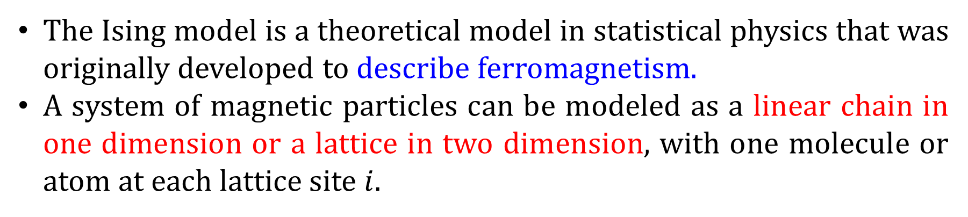
Definition: Ising Model
The Ising model is a theoretical model in statistical physics that was originally developed to describe ferromagnetism.
A system of magnetic particles can be modeled as a linear chain in one dimension or a lattice in two dimension, with one molecule or atom at each lattice site $i$.
https://stanford.edu/~jeffjar/statmech/lec3.html
Statistical Physics Seminar by Prof. Wolschin
Anton Kabelac

Slide 5
Definition: Ising Model
The Ising model is a theoretical model in statistical physics that was originally developed to describe ferromagnetism.
A system of magnetic particles can be modeled as a linear chain in one dimension or a lattice in two dimension, with one molecule or atom at each lattice site $i$.
An alloy; say, brass. Each of the sites is an atom in the lattice; -1 represents an copper atom at that site; +1 represents zinc.
A ‘‘lattice gas’’. Each of the sites is the possible location of a particle; -1 means that site is empty and +1 means that site is occupied by a particle.
https://stanford.edu/~jeffjar/statmech/lec3.html
Statistical Physics Seminar by Prof. Wolschin
Anton Kabelac

Slide 6
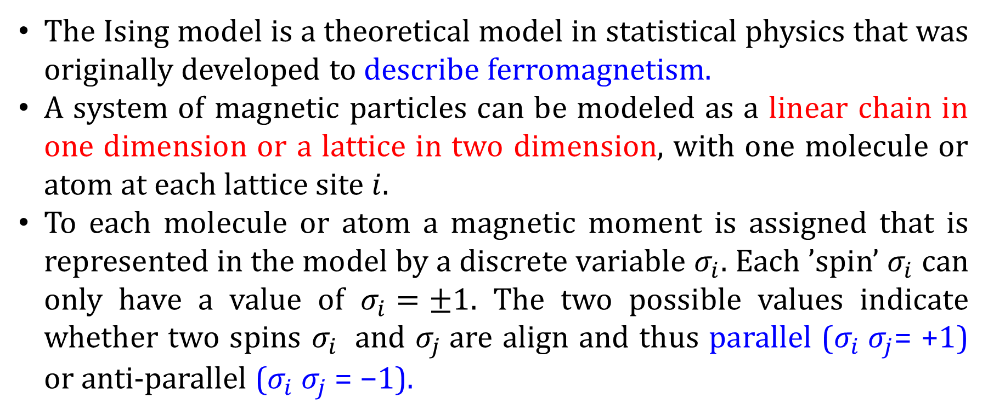
Ising Model
The Ising model is a theoretical model in statistical physics that was originally developed to describe ferromagnetism.
A system of magnetic particles can be modeled as a linear chain in one dimension or a lattice in two dimension, with one molecule or atom at each lattice site $i$.
To each molecule or atom a magnetic moment is assigned that is represented in the model by a discrete variable $σ_{i}$. Each ’spin’ $σ_{i}$ can only have a value of $σ_{i}=±1$. The two possible values indicate whether two spins $σ_{i}$ and $σ_{j}$are align and thus parallel ($σ_{i} σ_{j}$= +1) or anti-parallel ($σ_{i} σ_{j}$= −1).
https://stanford.edu/~jeffjar/statmech/lec3.html
Statistical Physics Seminar by Prof. Wolschin
Anton Kabelac

Slide 7
Ising Model
A system of two spins is considered to be in a lower energetic state if the two magnetic moments are aligned. If the magnetic moments points in opposite directions they are consider to be in a higher energetic state. Due to this interaction the system tends to align all magnetic moments in one direction in order to minimize energy.
https://stanford.edu/~jeffjar/statmech/lec3.html
Statistical Physics Seminar by Prof. Wolschin
Anton Kabelac

Slide 8
Ising Model
A system of two spins is considered to be in a lower energetic state if the two magnetic moments are aligned. If the magnetic moments points in opposite directions they are consider to be in a higher energetic state. Due to this interaction the system tends to align all magnetic moments in one direction in order to minimize energy.
If nearly all magnetic moments point in the same direction the arrangement of molecules behaves like a macroscopic magnet.
https://stanford.edu/~jeffjar/statmech/lec3.html

Slide 9
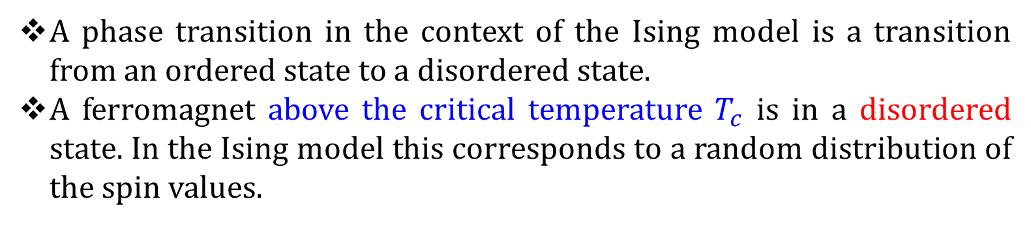
Ising Model
A phase transition in the context of the Ising model is a transition from an ordered state to a disordered state.
A ferromagnet above the critical temperature $T_{c}$ is in a disordered state. In the Ising model this corresponds to a random distribution of the spin values.
https://stanford.edu/~jeffjar/statmech/lec3.html

Slide 10
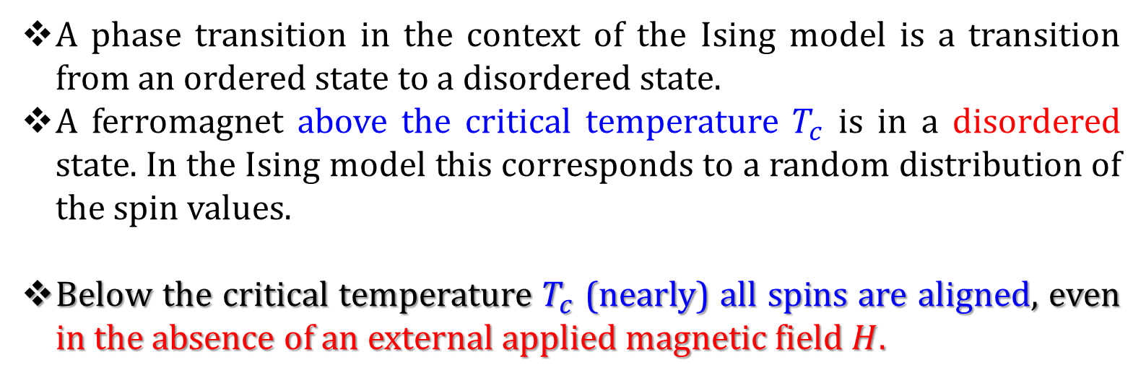
Ising Model
A phase transition in the context of the Ising model is a transition from an ordered state to a disordered state.
A ferromagnet above the critical temperature $T_{c}$ is in a disordered state. In the Ising model this corresponds to a random distribution of the spin values.
Below the critical temperature $T_{c}$ (nearly) all spins are aligned, even in the absence of an external applied magnetic field $H$.
https://stanford.edu/~jeffjar/statmech/lec3.html

Slide 11
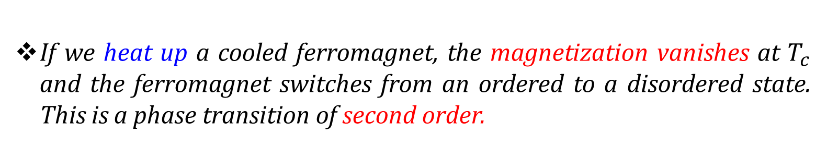
Ising Model
A phase transition in the context of the Ising model is a transition from an ordered state to a disordered state.
A ferromagnet above the critical temperature $T_{c}$ is in a disordered state. In the Ising model this corresponds to a random distribution of the spin values.
Below the critical temperature $T_{c}$ (nearly) all spins are aligned, even in the absence of an external applied magnetic field $H$.
If we heat up a cooled ferromagnet, the magnetization vanishes at $T_{c}$ and the ferromagnet switches from an ordered to a disordered state. This is a phase transition of second order.
https://stanford.edu/~jeffjar/statmech/lec3.html

Slide 15
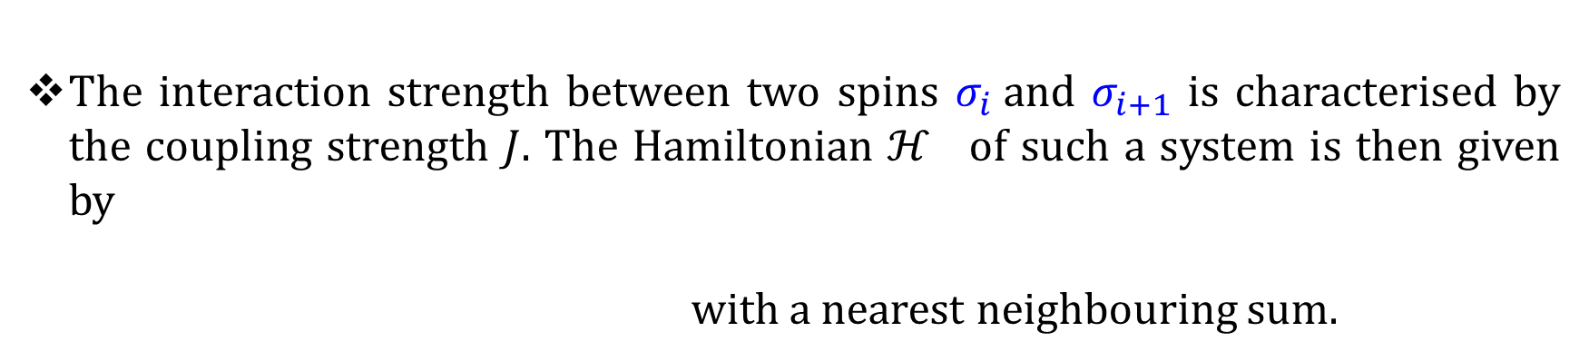
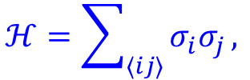
One dimensional Ising Model
Each spin can interact with its neighbors.
No external magnetic field is considered.
The interaction strength between two spins $σ_{i}$and $σ_{i+1}$ is characterised by the coupling strength $J$. The Hamiltonian $ℋ$ of such a system is then given by
with a nearest neighbouring sum.
$$ℋ=\sum_{⟨ij⟩}{σ_{i}σ_{j}},$$
https://stanford.edu/~jeffjar/statmech/lec3.html
Statistical Physics Seminar by Prof. Wolschin
Anton Kabelac

Slide 16
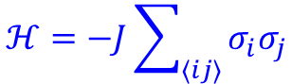
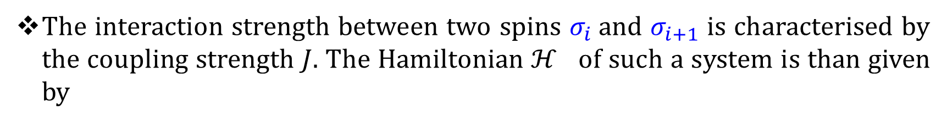
One dimensional Ising Model
The interaction strength between two spins $σ_{i}$and $σ_{i+1}$ is characterised by the coupling strength $J$. The Hamiltonian $ℋ$ of such a system is than given by
$$ℋ=−J\sum_{⟨ij⟩}{σ_{i}σ_{j}}$$
https://stanford.edu/~jeffjar/statmech/lec3.html
Statistical Physics Seminar by Prof. Wolschin
Anton Kabelac

Slide 17
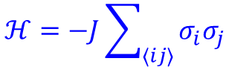
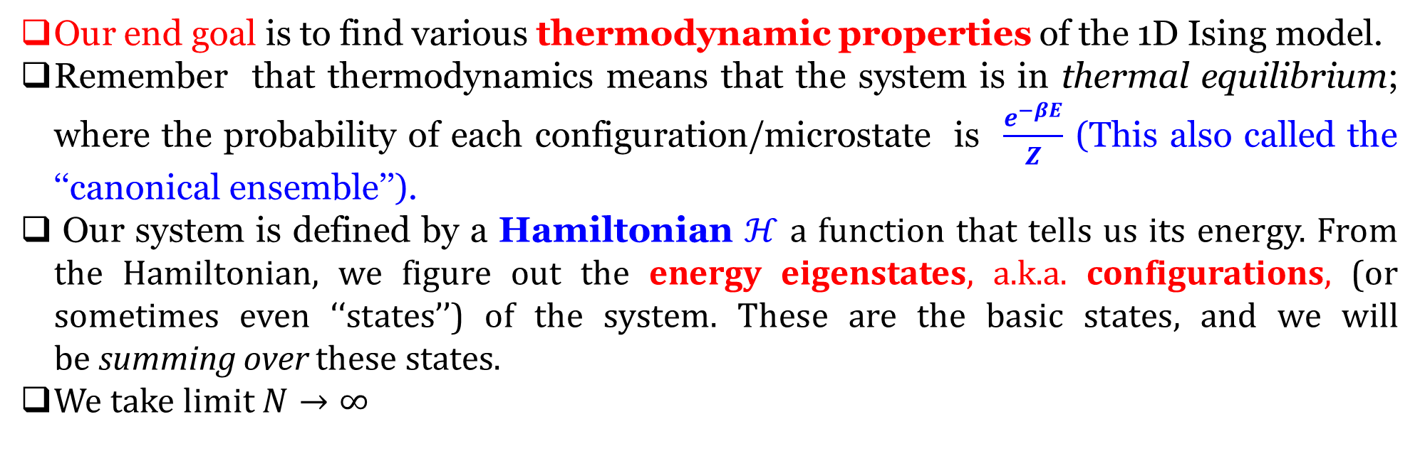
One dimensional Ising Model
The interaction strength between two spins $σ_{i}$and $σ_{i+1}$ is characterized by the coupling strength $J$. The Hamiltonian $ℋ$ of such a system is than given by
$$ℋ=−J\sum_{⟨ij⟩}{σ_{i}σ_{j}}$$
Our end goal is to find various thermodynamic properties of the 1D Ising model.
Remember that thermodynamics means that the system is in thermal equilibrium; where the probability of each configuration/microstate is $\frac{e^{−βE}}{Z}$ (This also called the ‘‘canonical ensemble’’).
Our system is defined by a Hamiltonian $ℋ$ a function that tells us its energy. From the Hamiltonian, we figure out the energy eigenstates, a.k.a. configurations, (or sometimes even ‘‘states’’) of the system. These are the basic states, and we will be summing over these states.
We take limit $N→∞$
https://stanford.edu/~jeffjar/statmech/lec3.html
Statistical Physics Seminar by Prof. Wolschin
Anton Kabelac

Slide 18
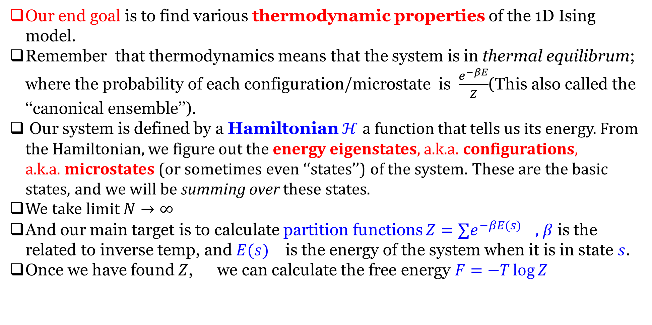
One dimensional Ising Model
Our end goal is to find various thermodynamic properties of the 1D Ising model.
Remember that thermodynamics means that the system is in thermal equilibrum; where the probability of each configuration/microstate is $\frac{e^{−βE}}{Z}$(This also called the ‘‘canonical ensemble’’).
Our system is defined by a Hamiltonian $ℋ$ a function that tells us its energy. From the Hamiltonian, we figure out the energy eigenstates, a.k.a. configurations, a.k.a. microstates (or sometimes even ‘‘states’’) of the system. These are the basic states, and we will be summing over these states.
We take limit $N→∞$
And our main target is to calculate partition functions $Z=∑e^{−β{E(s)}_{}} ,$ $β$ is the related to inverse temp, and ${E(s)}_{}$ is the energy of the system when it is in state $s$.
Once we have found $Z$, we can calculate the free energy $F=−T\log{Z}$
https://stanford.edu/~jeffjar/statmech/lec3.html
Statistical Physics Seminar by Prof. Wolschin
Anton Kabelac

Slide 19
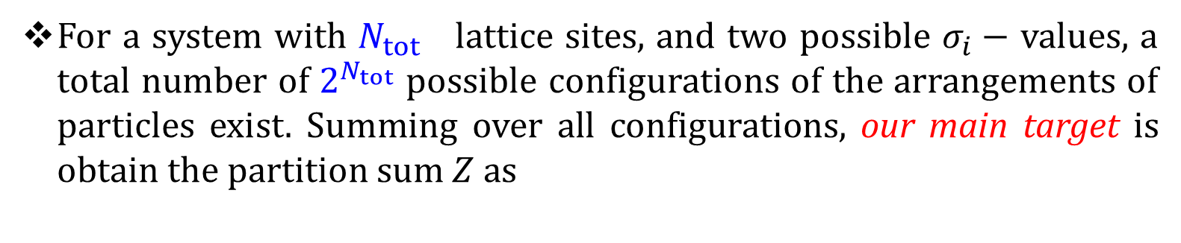
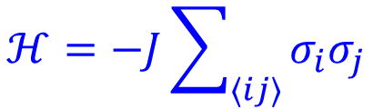
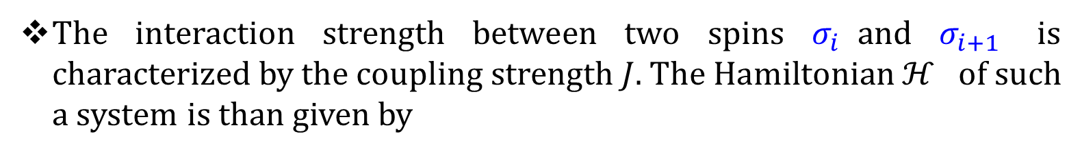
One dimensional Ising Model
The interaction strength between two spins $σ_{i}$and $σ_{i+1}$ is characterized by the coupling strength $J$. The Hamiltonian $ℋ$ of such a system is than given by
$$ℋ=−J\sum_{⟨ij⟩}{σ_{i}σ_{j}}$$
For a system with $N_{tot}$ lattice sites, and two possible $σ_{i}−$ values, a total number of $2^{N_{tot}}$ possible configurations of the arrangements of particles exist. Summing over all configurations, our main target is obtain the partition sum $Z$ as
$$Z=\sum_{ \{i\}}{e^{−βℋ} }=\sum_{ σ_{1}=±1}{\sum_{ σ_{2}=±1}{…….\sum_{ σ_{N}=±1}{e^{βJ(σ_{1}σ_{2}+σ_{2}σ_{3}+….)}}}}$$
https://stanford.edu/~jeffjar/statmech/lec3.html
Statistical Physics Seminar by Prof. Wolschin
Anton Kabelac

Slide 20
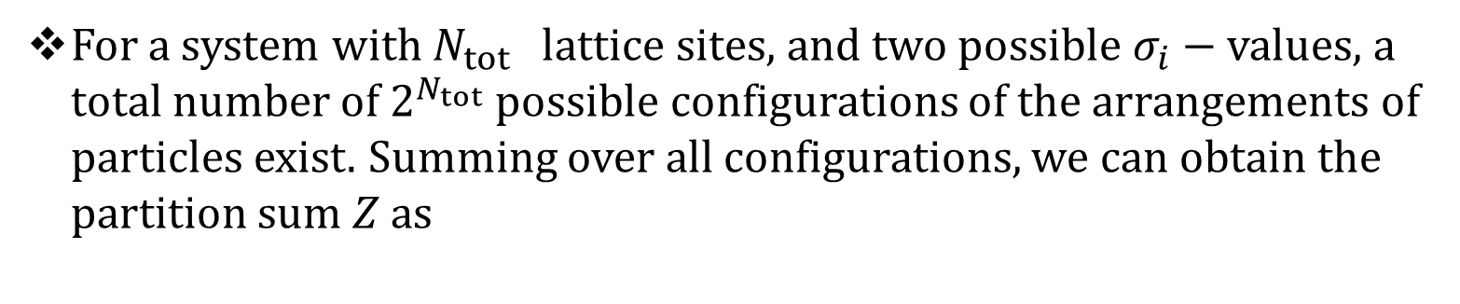
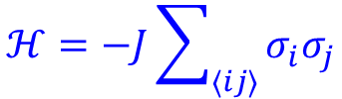
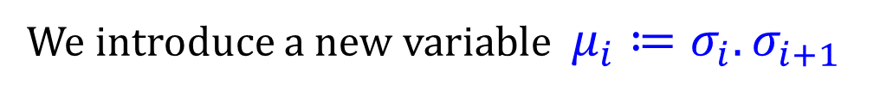
One dimensional Ising Model
For a system with $N_{tot}$ lattice sites, and two possible $σ_{i}−$ values, a total number of $2^{N_{tot}}$ possible configurations of the arrangements of particles exist. Summing over all configurations, we can obtain the partition sum $Z$ as
$$Z=\sum_{ \{i\}}{e^{−βℋ} }=\sum_{ σ_{1}=±1}{\sum_{ σ_{2}=±1}{…….\sum_{ σ_{N}=±1}{e^{βJ(σ_{1}σ_{2}+σ_{2}σ_{3}+….)}}}}$$
$$ℋ=−J\sum_{⟨ij⟩}{σ_{i}σ_{j}}$$
We introduce a new variable $μ_{i}≔σ_{i}.σ_{i+1}$
Statistical Physics Seminar by Prof. Wolschin
Anton Kabelac

Slide 21
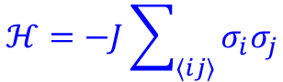
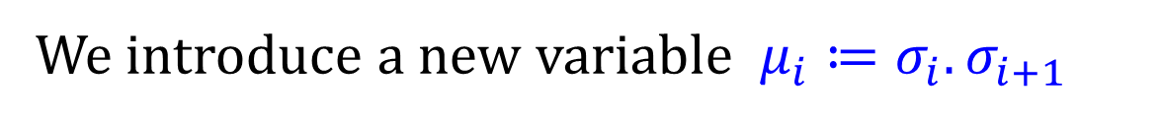
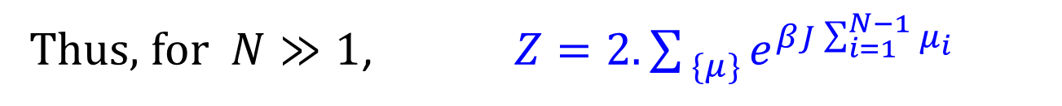
One dimensional Ising Model
For a system with $N_{tot}$ lattice sites, and two possible $σ_{i}−$ values, a total number of $2^{N_{tot}}$ possible configurations of the arrangements of particles exist. Summing over all configurations, we can obtain the partition sum $Z$ as
$$Z=\sum_{ \{i\}}{e^{−βℋ} }=\sum_{ σ_{1}=±1}{\sum_{ σ_{2}=±1}{…….\sum_{ σ_{N}=±1}{e^{βJ(σ_{1}σ_{2}+σ_{2}σ_{3}+….)}}}}$$
We introduce a new variable $μ_{i}≔σ_{i}.σ_{i+1}$
$$ℋ=−J\sum_{⟨ij⟩}{σ_{i}σ_{j}}$$
Thus, for $N≫1$, $Z=2.\sum_{ \{μ\}}{e^{βJ\sum_{i=1}^{N−1}{μ_{i}}} }$
The factor of 2 in the partition function arises from the two possible configurations for the first spin in the chain.
Statistical Physics Seminar by Prof. Wolschin
Anton Kabelac

Slide 22
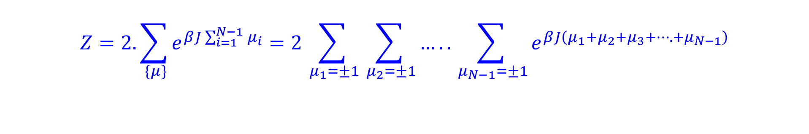
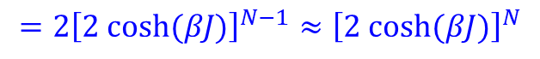
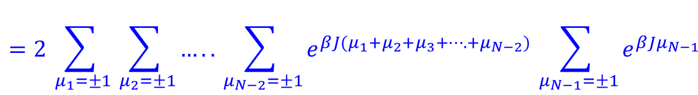
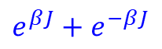
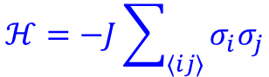
One dimensional Ising Model
$$ℋ=−J\sum_{⟨ij⟩}{σ_{i}σ_{j}}$$
$$Z=\sum_{ \{i\}}{e^{−βℋ} }=\sum_{ σ_{1}=±1}{\sum_{ σ_{2}=±1}{…….\sum_{ σ_{N}=±1}{e^{βJ(σ_{1}σ_{2}+σ_{2}σ_{3}+….)}}}}$$
$$Z=2.\sum_{ \{μ\}}{e^{βJ\sum_{i=1}^{N−1}{μ_{i}}}}=2\sum_{ μ_{1}=±1}{\sum_{ μ_{2}=±1}{…..\sum_{ μ_{N−1}=±1}{e^{βJ\left(μ_{1}+μ_{2}+μ_{3}+….+μ_{N−1}\right)}}}}$$
$$=2\sum_{ μ_{1}=±1}{\sum_{ μ_{2}=±1}{…..\sum_{ μ_{N−2}=±1}{e^{βJ(μ_{1}+μ_{2}+μ_{3}+….+μ_{N−2})}}\sum_{ μ_{N−1}=±1}{e^{βJμ_{N−1}}}}}$$
Open Boundary condition
$$=2{\left[2 cosh⁡(βJ)\right]}^{N−1}≈{\left[2 cosh⁡(βJ)\right]}^{N}$$
$e^{βJ}+$ $e^{−βJ}$
This is the partition function of the one-dimensional Ising model without an external field.
Statistical Physics Seminar by Prof. Wolschin
Anton Kabelac

Slide 23
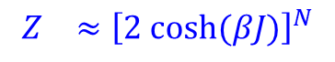
$$Z_{}≈{\left[2 cosh⁡(βJ)\right]}^{N}$$

Slide 24
One dimensional Ising Model
Reason for learning Ising model in 1-D.
Strategy: for a given Hamiltonian construct the partition function.
Weakness: Ising;s 1-d solution was unable to find the phase transition.
Q: What will happen if we add external magnetic field? How can we calculate that?
Statistical Physics Seminar by Prof. Wolschin
Anton Kabelac

Slide 25
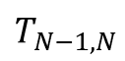
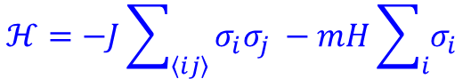
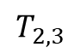
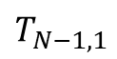
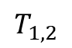
One dimensional Ising Model: Transfer matrix approach
The next question we are going to answer is what happens to our system if we apply an
external magnetic field H that can interact with the magnetic moment m of each spin. The
Hamiltonian of such a system becomes:
$$ℋ=−J\sum_{\left\langle ij\right\rangle }{σ_{i}σ_{j} }−mH\sum_{i}{σ_{i} }$$
In that case, we will consider the periodic boundary condition. We define a transfer matrix in a following way,
$e^{−βℋ}=e^{βE(σ_{1},σ_{2})}$ $e^{βE(σ_{2},σ_{3})}$ …….. $e^{βE(σ_{N−1},σ_{N})}e^{βE(σ_{N},σ_{1})}$
$$T_{1,2}$$
$$T_{2,3}$$
$$T_{N−1,N}$$
$$T_{N−1,1}$$
Statistical Physics Seminar by Prof. Wolschin
Anton Kabelac

Slide 26
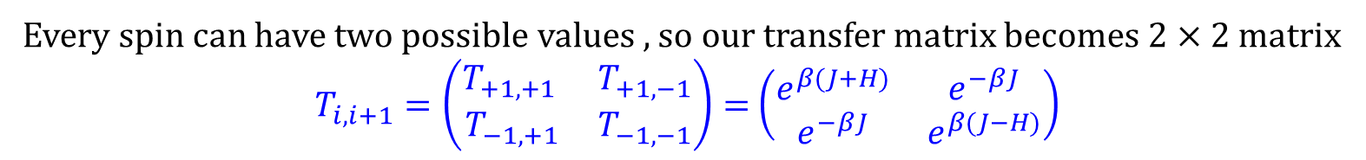
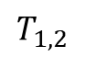
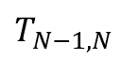
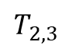
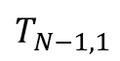
One dimensional Ising Model:Transfer matrix
$e^{−βℋ}=e^{βE(σ_{1},σ_{2})}$ $e^{βE(σ_{2},σ_{3})}$ …….. $e^{βE(σ_{N−1},σ_{N})}e^{βE(σ_{N},σ_{1})}$
$$T_{1,2}$$
$$T_{2,3}$$
$$T_{N−1,N}$$
$$T_{N−1,1}$$
So each transfer matrix is given by $T_{i,i+1}=\exp{(β(J σ_{i}σ_{i+1 }+\frac{1}{2}H\left(σ_{i}+σ_{i+1}\right)))}$
Every spin can have two possible values , so our transfer matrix becomes $2×2$ matrix
$T_{i,i+1}=\left(\begin{matrix}T_{+1,+1 } & T_{+1, −1} \\ T_{−1,+1} & T_{−1,−1}\end{matrix}\right)=$ $\left(\begin{matrix}e^{β(J+H)} & e^{−βJ} \\ e^{−βJ} & e^{β(J−H)}\end{matrix}\right)$
Statistical Physics Seminar by Prof. Wolschin
Anton Kabelac

Slide 27
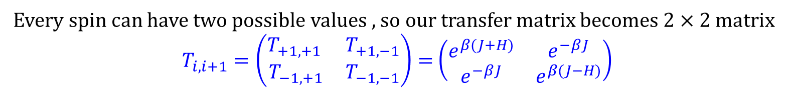
One dimensional Ising Model:Transfer matrix
So each transfer matrix is given by $T_{i,i+1}=\exp{(β(J σ_{i}σ_{i+1 }+\frac{1}{2}H\left(σ_{i}+σ_{i+1}\right)))}$
Every spin can have two possible values , so our transfer matrix becomes $2×2$ matrix
$T_{i,i+1}=\left(\begin{matrix}T_{+1,+1 } & T_{+1, −1} \\ T_{−1,+1} & T_{−1,−1}\end{matrix}\right)=$ $\left(\begin{matrix}e^{β(J+H)} & e^{−βJ} \\ e^{−βJ} & e^{β(J−H)}\end{matrix}\right)$
Now we can write down the partition function in terms of the transfer matrices
$$Z=\sum_{ \{i\}}{e^{−βℋ} }=\sum_{ σ_{1}=±1}{\sum_{ σ_{2}=±1}{…….\sum_{ σ_{N}=±1}{T_{1,2}….. T_{N,1}}}}$$
Statistical Physics Seminar by Prof. Wolschin
Anton Kabelac

Slide 28
One dimensional Ising Model:Transfer matrix
So each transfer matrix is given by $T_{i,i+1}=\exp{(β(J σ_{i}σ_{i+1 }+\frac{1}{2}H\left(σ_{i}+σ_{i+1}\right)))}$
Every spin can have two possible values , so our transfer matrix becomes $2×2$ matrix
$T_{i,i+1}=\left(\begin{matrix}T_{+1,+1 } & T_{+1, −1} \\ T_{−1,+1} & T_{−1,−1}\end{matrix}\right)=$ $\left(\begin{matrix}e^{β(J+H)} & e^{−βJ} \\ e^{−βJ} & e^{β(J−H)}\end{matrix}\right)$
Now we can write down the partition function in terms of the transfer matrices
$$Z=\sum_{ \{i\}}{e^{−βℋ} }=\sum_{ σ_{1}=±1}{\sum_{ σ_{2}=±1}{…….\sum_{ σ_{N}=±1}{T_{1,2}….. T_{N,1}}}}$$
If we zoom in on the multiplication between the 1-2 transfer matrix and the 2-3 transfer matrix, we see that
the transfer matrices are being multiplied by each other when we sum over their shared
index $σ_{2}$
Statistical Physics Seminar by Prof. Wolschin
Anton Kabelac

Slide 29
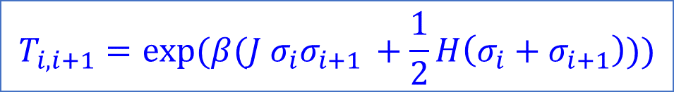
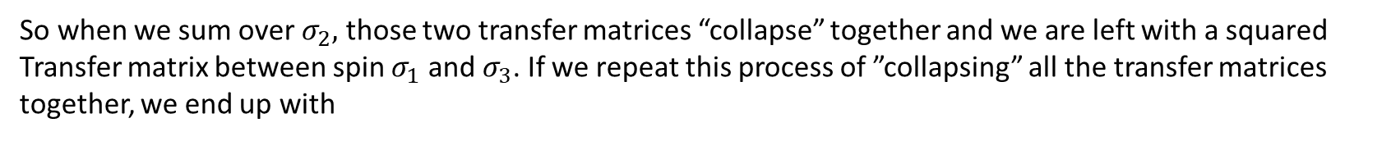
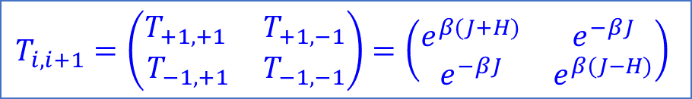
One dimensional Ising Model:Transfer matrix
$$T_{i,i+1}=\exp{(β(J σ_{i}σ_{i+1 }+\frac{1}{2}H\left(σ_{i}+σ_{i+1}\right)))}$$
$$T_{i,i+1}=\left(\begin{matrix}T_{+1,+1 } & T_{+1, −1} \\ T_{−1,+1} & T_{−1,−1}\end{matrix}\right)=\left(\begin{matrix}e^{β(J+H)} & e^{−βJ} \\ e^{−βJ} & e^{β(J−H)}\end{matrix}\right)$$
$$Z=\sum_{ \{i\}}{e^{−βℋ} }=\sum_{ σ_{1}=±1}{\sum_{ σ_{2}=±1}{…….\sum_{ σ_{N}=±1}{T_{1,2}….. T_{N,1}}}}$$
So when we sum over $σ_{2},$ those two transfer matrices “collapse” together and we are left with a squared
Transfer matrix between spin $σ_{1}$ and $σ_{3}$. If we repeat this process of ”collapsing” all the transfer matrices together, we end up with
$$Z=tr\left[T^{N}\right]=λ_{1}^{N}+λ_{2}^{N}$$
Statistical Physics Seminar by Prof. Wolschin
Anton Kabelac

Slide 30
One dimensional Ising Model:Transfer matrix
$$T_{i,i+1}=\exp{(β(J σ_{i}σ_{i+1 }+\frac{1}{2}H\left(σ_{i}+σ_{i+1}\right)))}$$
$$T_{i,i+1}=\left(\begin{matrix}T_{+1,+1 } & T_{+1, −1} \\ T_{−1,+1} & T_{−1,−1}\end{matrix}\right)=\left(\begin{matrix}e^{β(J+H)} & e^{−βJ} \\ e^{−βJ} & e^{β(J−H)}\end{matrix}\right)$$
Statistical Physics Seminar by Prof. Wolschin
Anton Kabelac

Slide 31
One dimensional Ising Model:Transfer matrix
$$T_{i,i+1}=\exp{(β(J σ_{i}σ_{i+1 }+\frac{1}{2}H\left(σ_{i}+σ_{i+1}\right)))}$$
$$T_{i,i+1}=\left(\begin{matrix}T_{+1,+1 } & T_{+1, −1} \\ T_{−1,+1} & T_{−1,−1}\end{matrix}\right)=\left(\begin{matrix}e^{β(J+H)} & e^{−βJ} \\ e^{−βJ} & e^{β(J−H)}\end{matrix}\right)$$
h and H are same
Statistical Physics Seminar by Prof. Wolschin
Anton Kabelac

Slide 32
One dimensional Ising Model:Transfer matrix
$$T_{i,i+1}=\exp{(β(J σ_{i}σ_{i+1 }+\frac{1}{2}H\left(σ_{i}+σ_{i+1}\right)))}$$
$$T_{i,i+1}=\left(\begin{matrix}T_{+1,+1 } & T_{+1, −1} \\ T_{−1,+1} & T_{−1,−1}\end{matrix}\right)=\left(\begin{matrix}e^{β(J+H)} & e^{−βJ} \\ e^{−βJ} & e^{β(J−H)}\end{matrix}\right)$$
Harvey Gould and Jan Tobochnik
Statistical Physics Seminar by Prof. Wolschin
Anton Kabelac

Slide 33
One dimensional Ising Model:Transfer matrix
$$T_{i,i+1}=\exp{(β(J σ_{i}σ_{i+1 }+\frac{1}{2}H\left(σ_{i}+σ_{i+1}\right)))}$$
$$T_{i,i+1}=\left(\begin{matrix}T_{+1,+1 } & T_{+1, −1} \\ T_{−1,+1} & T_{−1,−1}\end{matrix}\right)=\left(\begin{matrix}e^{β(J+H)} & e^{−βJ} \\ e^{−βJ} & e^{β(J−H)}\end{matrix}\right)$$
H
Harvey Gould and Jan Tobochnik
Statistical Physics Seminar by Prof. Wolschin
Anton Kabelac

Slide 34
One dimensional Ising Model:Transfer matrix

Slide 35
Phase Transition in 2-d Ising model

Slide 36
Phase Transition in 2-d Ising model of a Ferromagnet
The two-dimensional Ising model was solved exactly in zero magnetic eld for a rectangular lattice by Lars Onsager in 1944. Onsager's calculation was the first exact solution that exhibited a phase transition in a model with short-range interactions. Before his calculation, some people believed that statistical mechanics was not capable of yielding a phase transition.

Slide 37
Phase Transition in 2-d Ising model of a Ferromagnet
In most ordinary materials the associated magnetic dipoles of the atoms have a random orientation. In effect this non-specific distribution results in no overall macroscopic magnetic moment. However in certain cases, such as iron, a magnetic moment is produced as a result of a preferred alignment of the atomic spins.
This phenomenon is based on two fundamental principles, namely energy minimization and entropy maximization.
These are competing principles and are important in moderating the overall effect. Temperature is the mediator between these opposing elements and ultimately determines which will be more dominant
Jacques Kotze
arXiv:0803.0217v1

Slide 38
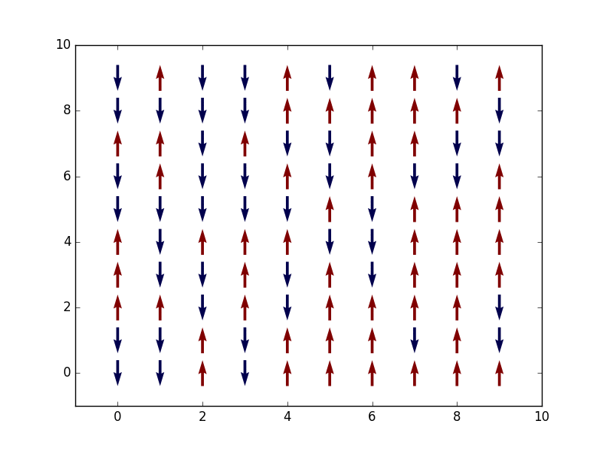
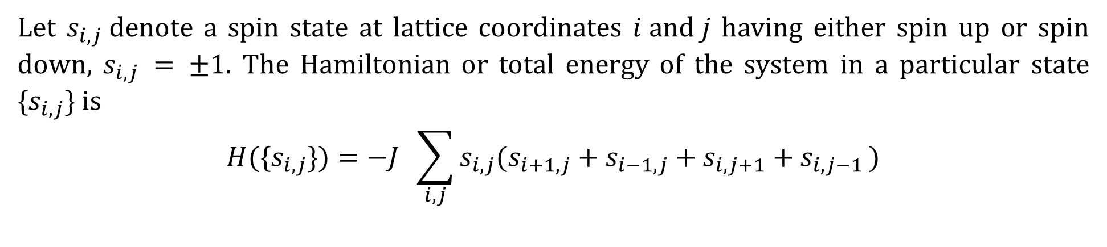
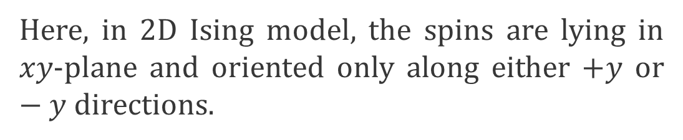
Phase Transition in 2-d Ising model of a Ferromagnet
Aim: Critical Temperature for phase transition
Let $s_{i,j}$denote a spin state at lattice coordinates $i and j$ having either spin up or spin down, $s_{i,j} = ±1$. The Hamiltonian or total energy of the system in a particular state {$s_{i,j}\}$ is
$$H(\text{\{}s_{i,j}\})=−J \sum_{i,j}{s_{i,j}(s_{i+1,j}+s_{i−1,j}+s_{i,j+1}+s_{i,j−1 })}$$
Here, in 2D Ising model, the spins are lying in $xy$​-plane and oriented only along either $+y$​ or $−y$directions.
https://ruihaoqiu.github.io/MC-Magnetic-Phase-Transition/

Slide 39
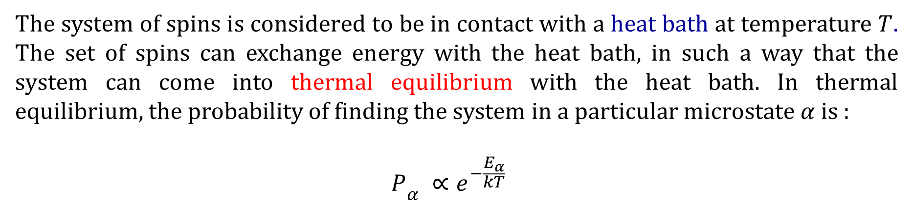
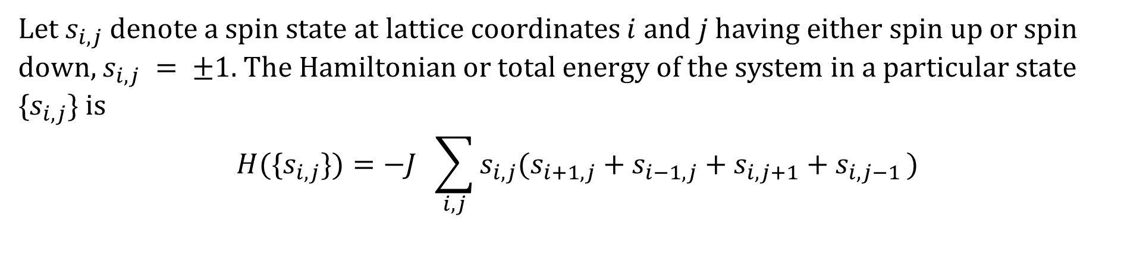
Phase Transition in 2-d Ising model of a Ferromagnet
Aim: Critical Temperature for phase transition
Let $s_{i,j}$denote a spin state at lattice coordinates $i and j$ having either spin up or spin down, $s_{i,j} = ±1$. The Hamiltonian or total energy of the system in a particular state {$s_{i,j}\}$ is
$$H(\text{\{}s_{i,j}\})=−J \sum_{i,j}{s_{i,j}(s_{i+1,j}+s_{i−1,j}+s_{i,j+1}+s_{i,j−1 })}$$
Periodic boundary condition (2 d lattice folded in torus) and only a nearest neighbour coupling is allowed.
The system of spins is considered to be in contact with a heat bath at temperature $T$. The set of spins can exchange energy with the heat bath, in such a way that the system can come into thermal equilibrium with the heat bath. In thermal equilibrium, the probability of finding the system in a particular microstate $α$ is :
$${P_{ }}_{α} ∝e^{−\frac{E_{α}}{kT}}$$

Slide 40
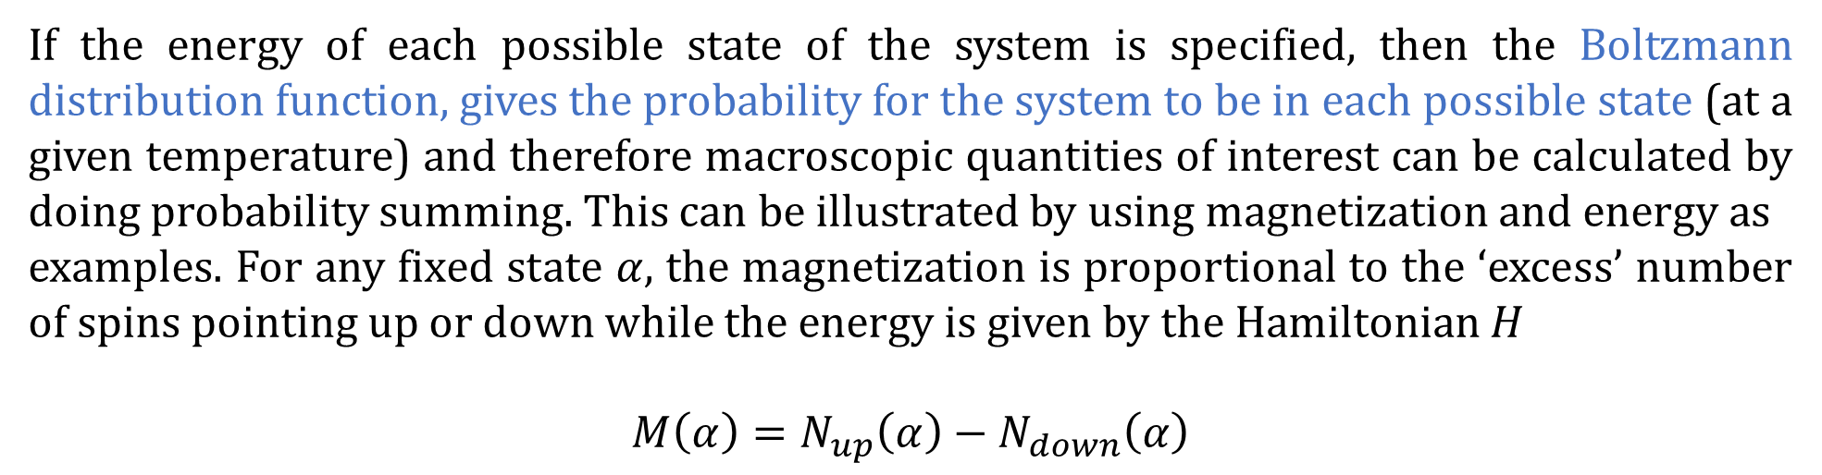
Phase Transition in 2-d Ising model of a Ferromagnet
Aim: Critical Temperature for phase transition
Let $s_{i,j}$denote a spin state at lattice coordinates $i and j$ having either spin up or spin down, $s_{i,j} = ±1$. The Hamiltonian or total energy of the system in a particular state {$s_{i,j}\}$ is
$$H(\text{\{}s_{i,j}\})=−J \sum_{i,j}{s_{i,j}(s_{i+1,j}+s_{i−1,j}+s_{i,j+1}+s_{i,j−1 })}$$
If the energy of each possible state of the system is specified, then the Boltzmann distribution function, gives the probability for the system to be in each possible state (at a given temperature) and therefore macroscopic quantities of interest can be calculated by doing probability summing. This can be illustrated by using magnetization and energy as
examples. For any fixed state $α$, the magnetization is proportional to the ‘excess’ number of spins pointing up or down while the energy is given by the Hamiltonian $H$
$$M\left(α\right)=N_{up}\left(α\right)−N_{down}\left(α\right)$$
Jacques Kotze

Slide 41


Phase Transition in 2-d Ising model of a Ferromagnet
Aim: Critical Temperature for phase transition
Let $s_{i,j}$denote a spin state at lattice coordinates $i and j$ having either spin up or spin down, $s_{i,j} = ±1$. The Hamiltonian or total energy of the system in a particular state {$s_{i,j}\}$ is
$$H(\text{\{}s_{i,j}\})=−J \sum_{i,j}{s_{i,j}(s_{i+1,j}+s_{i−1,j}+s_{i,j+1}+s_{i,j−1 })}$$
$$M\left(α\right)=N_{up}\left(α\right)−N_{down}\left(α\right)$$
Thus, expected value $\left\langle M\right\rangle =\sum_{α}{M\left(α\right)P_{α}}.$ similarly, $\left\langle E\right\rangle =\sum_{α}{E\left(α\right)P_{α}}$
These calculation pose a drastic problem from a practical perspective. Considering we have two spin orientations (up & down) and there are $N$ spins which implies that there are $2^{N}$ different states. As $N$ becomes large it is evident that computations become a daunting task if calculated in this manner.
Jacques Kotze

Slide 42
Branislav K. Nikolić

Slide 43
Branislav K. Nikolić

Slide 45



Phase transition: computation(2 d lattice)
$$H(\text{\{}s_{i,j}\})=−J \sum_{i,j}{s_{i,j}(s_{i+1,j}+s_{i−1,j}+s_{i,j+1}+s_{i,j−1 })}$$
Wei Cai Stanford University

Slide 46
Phase transition: computation(2 d lattice)
adj = neighbors(1:N^2,N);
% grid = sign(randn(N,N));
p=.5; % average proportion of initial +1 spins
grid = sign(p-rand(N));

Slide 47

Phase transition: computation(2 d lattice)
adj = neighbors(1:N^2,N);
% grid = sign(randn(N,N));
p=.5; % average proportion of initial +1 spins
grid = sign(p-rand(N));
for T = 1.57:0.1:5;
kT = 1*T;
s=randi(N^2);
% location of ith spin
% s = spin(i);
% Calculate the change in energy of flipping s
dE = 2*J*grid(s)*sum(grid(adj(s,:)));
% Calculate the transition probability
p = exp(-dE/kT);
% Decide if a transition will occur
if dE<=0 || rand <= p,
grid(s) = -1*grid(s);
end
$$H(\text{\{}s_{i,j}\})=−J \sum_{i,j}{s_{i,j}(s_{i+1,j}+s_{i−1,j}+s_{i,j+1}+s_{i,j−1 })}$$

Slide 50
Metropolis- Hastings algorithm
The Monte Carlo approach (Hammersley and Handscomb, 1964; Rubinstein, 1981) emerged with computers, at the end of WWII, as it relies on the ability of producing a large number of realisations of a random variable distributed according to a given distribution, taking advantage of the stabilisation of the empirical average predicted by the Law of Large Numbers.
However, producing simulations from a specific distribution may prove near impossible or quite costly and therefore the (standard) Monte Carlo may also face intractable situations.
C.P Robert

Slide 51
Metropolis- Hastings algorithm
An indirect approach to the simulation of complex distributions and in particular to the curse of dimensionality met by regular Monte Carlo methods is to use a Markov chain associated with this target distribution, using Markov chain theory to validate the convergence of the chain to the distribution of interest and the stabilisation of empirical averages (Meyn and Tweedie, 1994).
Markov chains construct a progressive picture of the target distribution, proceeding by local exploration of the state space X until all the regions of interest have been uncovered. An analogy for the method is the case of a visitor to a museum forced by a general blackout to watch a painting with a small torch. Due to the narrow beam of the torch, the person cannot get a global view of the painting but can proceed along this painting until all parts have been seen.
C.P Robert

Slide 52
Metropolis algorithm

Slide 53

Ising Model: Motivation
https://www.bdhammel.com/ising-model/
https://www.quantamagazine.org/the-cartoon-picture-of-magnets-that-has-transformed-science-20200624/
https://stanford.edu/~jeffjar/statmech/lec3.html
Statistical Physics Seminar by Prof. Wolschin
Anton Kabelac

